Slide 1
COMMERCE –III ( MF)
Dr. Sumita Shankar

Slide 2
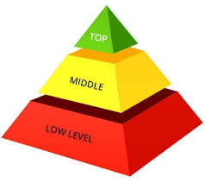
LEVELS OF MANAGEMENT

Slide 3

TOP LEVEL MANAGEMENT

Slide 4

MIDDLE LEVEL MANAGEMENT

Slide 5

LOWER LEVEL MANAGEMENT

Slide 6
